Slide 1
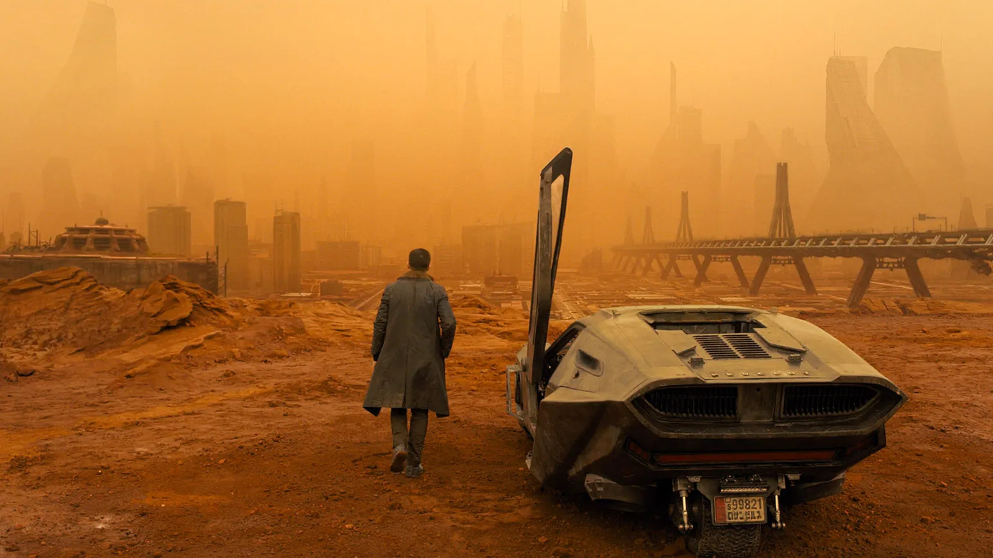
LIME
SHAP
IG
GradCAM
SmoothGrad
ML Developer and Practitioner
Exploring the Explanation Landscape

Slide 2
Overview
Reliability pillars
OpenXAI
Is OpenXAI all you need?
New directions

Slide 3
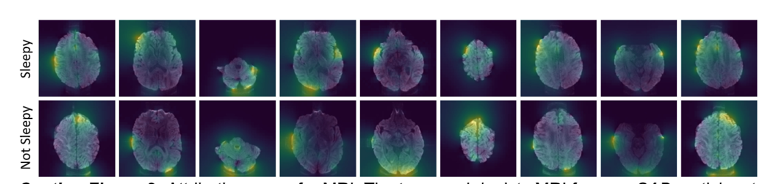
Deconvnet: Visualizing and understanding convolutional networks. Zeiler et al. 2014
Guided-backprop: Striving for simplicity: The all convolutional net. Springenberg et al. 2015
Integrated Gradients: Axiomatic Attribution for Deep Networks. Sundararajan et al. 2018
CAM: Learning Deep Features for Discriminative Localization. Zhou et al. 2016
LIME: Why should i trust you?: Explaining the predictions of any classifier. Ribeiro et al 2016
SmoothGrad: removing noise by adding noise. Smilkov et al. 2017
MP: Interpretable Explanations of Black Boxes by Meaningful Perturbation. Fong et al. 2017
SHAP: A Unified Approach to Interpreting Model Predictions. Lundberg et al. 2017
PDA: Visualizing deep neural network decisions: Prediction difference analysis. Zintgraf et al. 2017
Grad-CAM: Visual Explanations from Deep Networks via Gradient-based Localization. Selvaraju et al. 2017
Grad-CAM++: Improved Visual Explanations for Deep Convolutional Networks. Chattopadhyay et al. 2017
LRP: Beyond saliency: understanding convolutional neural networks from saliency prediction on layer-wise relevance propagation
DeepLIFT: Learning important features through propagating activation differences. Shrikumar et al. 2017
RISE: Randomized Input Sampling for Explanation of Black-box Models. Petsiuk et al. 2018
FIDO: Explaining image classifiers by counterfactual generation. Chang et al. 2019
Expected Gradients: Learning Explainable Models Using Attribution Priors. Erion et al. 2019
FG-Vis: Interpretable and Fine-Grained Visual Explanations for Convolutional Neural Networks. Wagner et al. CVPR 2019
Understanding Deep Networks via Extremal Perturbations and Smooth Masks. Fong et al. ICCV 2019
MP-G: Removing input features via a generative model to explain their attributions to classifier's decisions. Agarwal et al. 2020
Natural images Fong et al. 2017
MRI brain scans Agarwal et al. 2021
Text Ribeiro et al. 2016
Videos
Srinivasan et al. 2017
Audio
Becker et al. 2019
. . .
Notes:
dozens of explanation methods have been proposed and applied to a variety of domains including MRI scans, natural images, text classifications, videos and speech.

Slide 4
Chest X-ray
Rajpurkar et al. 2017
Deconvnet: Visualizing and understanding convolutional networks. Zeiler et al. 2014
Guided-backprop: Striving for simplicity: The all convolutional net. Springenberg et al. 2015
Integrated Gradients: Axiomatic Attribution for Deep Networks. Sundararajan et al. 2018
CAM: Learning Deep Features for Discriminative Localization. Zhou et al. 2016
LIME: Why should i trust you?: Explaining the predictions of any classifier. Ribeiro et al. 2016
SmoothGrad: removing noise by adding noise. Smilkov et al. 2017
MP: Interpretable Explanations of Black Boxes by Meaningful Perturbation. Fong et al. 2017
SHAP: A Unified Approach to Interpreting Model Predictions. Lundberg et al. 2017
PDA: Visualizing deep neural network decisions: Prediction difference analysis. Zintgraf et al. 2017
Grad-CAM: Visual Explanations from Deep Networks via Gradient-based Localization. Selvaraju et al. 2017
Grad-CAM++: Improved Visual Explanations for Deep Convolutional Networks. Chattopadhyay et al. 2017
LRP: Beyond saliency: understanding convolutional neural networks from saliency prediction on layer-wise relevance propagation
DeepLIFT: Learning important features through propagating activation differences. Shrikumar et al. 2017
RISE: Randomized Input Sampling for Explanation of Black-box Models. Petsiuk et al. 2018
FIDO: Explaining image classifiers by counterfactual generation. Chang et al. 2019
Expected Gradients: Learning Explainable Models Using Attribution Priors. Erion et al. 2019
FG-Vis: Interpretable and Fine-Grained Visual Explanations for Convolutional Neural Networks. Wagner et al. CVPR 2019
Understanding Deep Networks via Extremal Perturbations and Smooth Masks. Fong et al. ICCV 2019
MP-G: Removing input features via a generative model to explain their attributions to classifier's decisions. Agarwal et al. 2020
Natural images Fong et al. 2017
MRI brain scans Agarwal et al. 2021
Detecting biases Lapuschkin et al. 2016
Text Ribeiro et al. 2016
Videos
Srinivasan et al. 2017
Audio
Becker et al. 2019
. . .
Notes:
explanations have been useful in localizing malignant tumors in chess x-ray scans or in detecting biases in object recognition models.

Slide 5
How do we evaluate the reliability of state-of-the-art explanation methods?

Slide 6
Reliability Pillars
FA I THFUL
STABLE
FAIR
C. Agarwal, M. Zitnik, H. Lakkaraju, Probing GNN Explainers: A Rigorous Theoretical and Empirical Analysis of GNN Explanation Methods, AISTATS’ 2022.

Slide 7
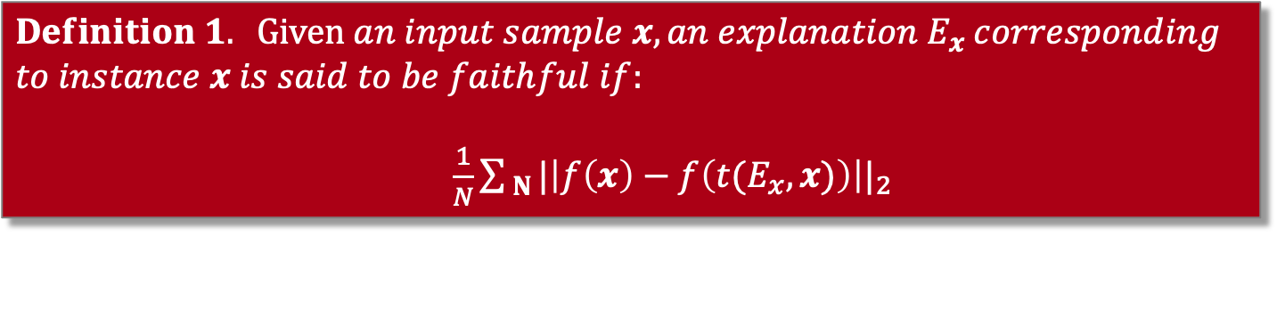
Pillar 1: Faithfulness
$$Definition 1. Given an input sample x, an explanation E_{x} corresponding \\ to instance x is said to be faithful if:$$ $\frac{1}{N}\sum_{ N}{{|\left|f\left(x\right)−f\left(t(E_{x}, x)\right)\right||}_{2}}$
Prediction model to be explained
Masking function

Slide 8
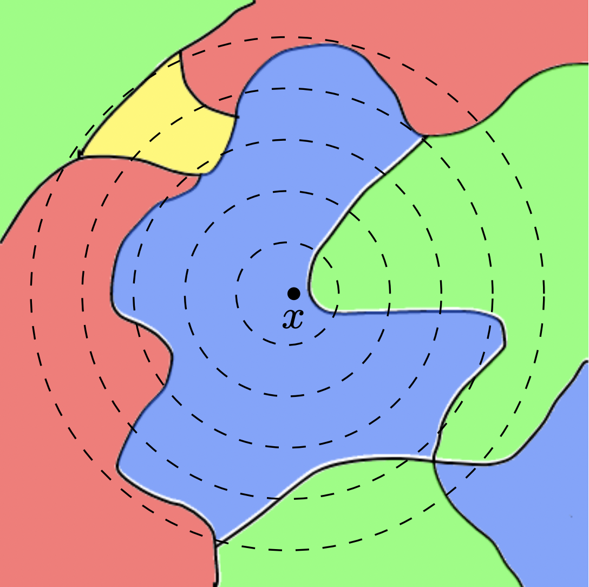
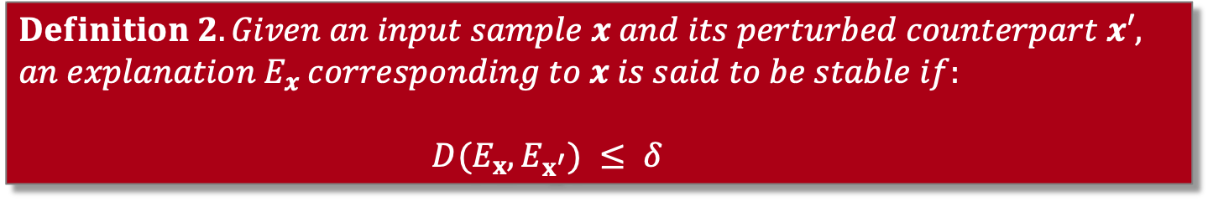
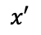
Pillar 2: Stability
$$Definition 2.Given an input sample x and its perturbed counterpart x′, \\ an explanation E_{x} corresponding to x is said to be stable if:$$ $${ D(E_{x},E}_{x^{′}}) ≤ δ$$
$$x′$$
C. Agarwal et al., Rethinking Stability for Attribution-based Explanations, Oral presentation @ ICLR 2022 PAIR^2Struct workshop.

Slide 9
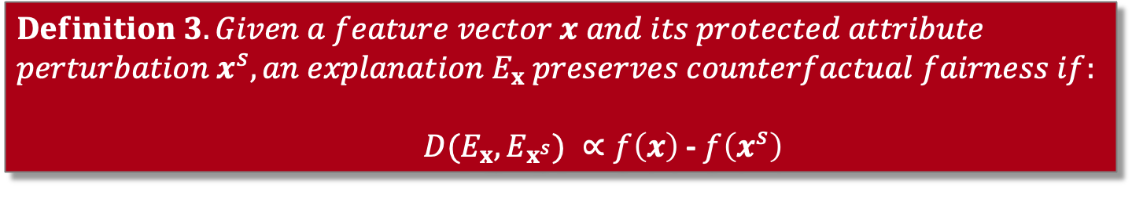
Pillar 3: Counterfactual Fairness
$$Definition 3.Given a feature vector x and its protected attribute \\ perturbation x^{s}, an explanation E_{x} preserves counterfactual fairness if:$$ ${D(E_{x},E}_{x^{s}}) ∝f\left(x\right)$ - $f\left(x^{s}\right)$
J. Dai et al., Fairness via Explanation Quality: Evaluating Disparities in the Quality of Post hoc Explanations, AIES’2022.

Slide 10
How do we pick an explanation method from the XAI landscape?

Slide 11
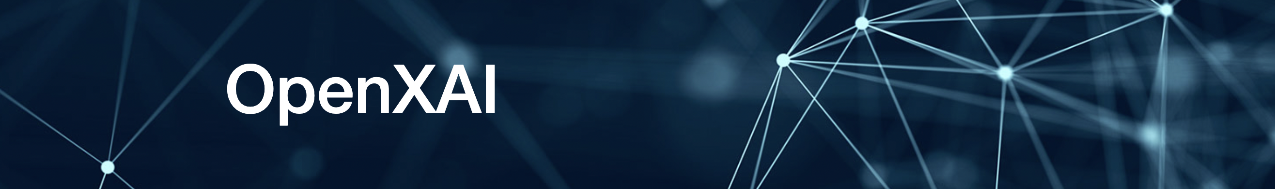
OpenXAI provides an automated end-to-end pipeline that simplifies and standardizes the evaluation of post hoc explanation methods
OpenXAI promotes transparency and reproducibility in benchmarking explanation methods
https://github.com/AI4LIFE-GROUP/OpenXAI
C. Agarwal et al., OpenXAI: Towards a Transparent Evaluation of Model Explanations, NeurIPS Datasets and Benchmark Track’2022.

Slide 12
OpenXAI’s Key Components
A flexible synthetic data generator and a collection of diverse 7 real-world datasets, 16 pre-trained models, and 6 state-of-the-art explanation methods
Open-source implementations of 22 quantitative metrics for evaluating faithfulness, stability (robustness), and fairness of explanation methods
First-ever public XAI leaderboards to benchmark explanation methods

Slide 13
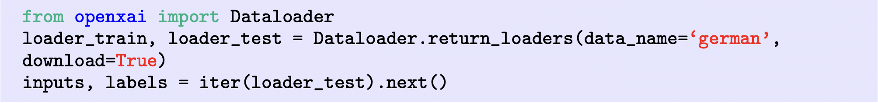
XAI ready Dataloaders and Models

Slide 14
XAI ready Dataloaders and Models
OpenXAI provides pre-trained models for readily benchmarking explanation methods.

Slide 15
OpenXAI Explainers
OpenXAI provides ready-to-use implementations of six state-of-the-art feature attribution methods

Slide 16
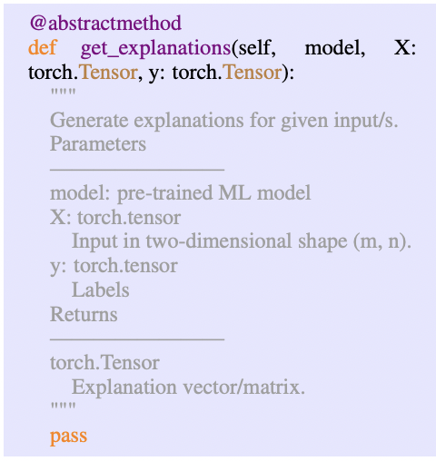
OpenXAI Explainers

Slide 17
OpenXAI’s Evaluation
OpenXAI provides implementations and ready-to-use APIs for a set of 22 quantitative metrics proposed by prior research to evaluate the faithfulness, stability, and fairness of explanation methods

Slide 18
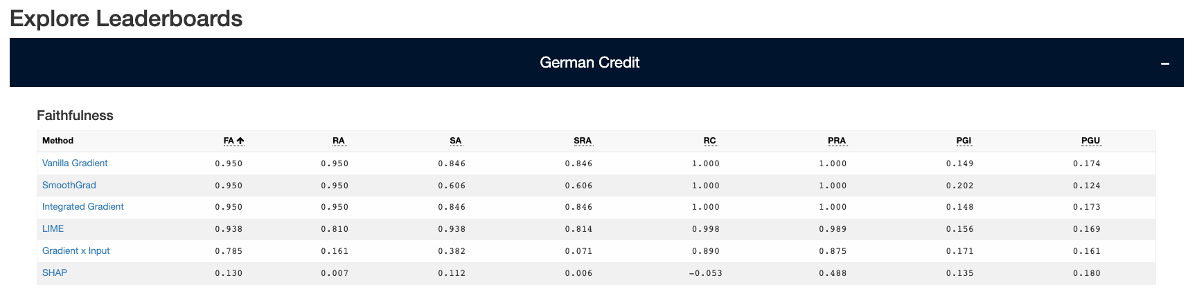
OpenXAI’s Leaderboard

Slide 19
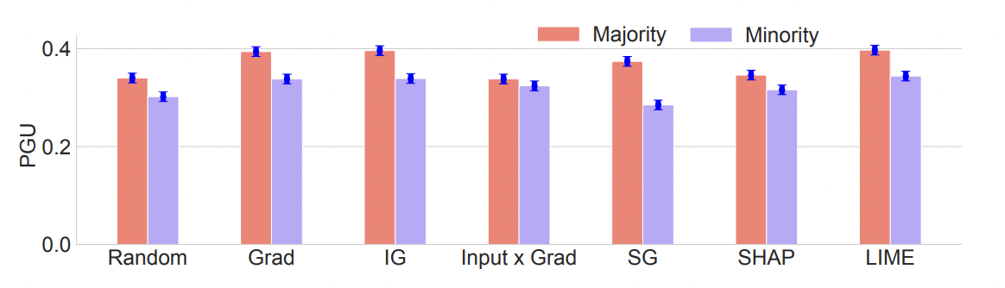
Exploring the landscape using OpenXAI
LIME produces more faithful (+24.9%) explanations
Across all real-world datasets, SmoothGrad achieves 63.2% higher RRS values

Slide 20
Is OpenXAI all you need?
How to benchmark different non-perturbation-based explanation methods?
Benchmarking explanations on other modalities
Vision (Quantus)
NLP (e-ViL)
Graphs (GraphXAI)
C. Agarwal et al., Evaluating Explainability for Graph Neural Networks, Nature Scientific Data’2023
M. Kayser et al., e-ViL: A Dataset and Benchmark for Natural Language Explanations in Vision-Language Tasks, ICCV’2021 A. Hedstrom et al., Quantus: An Explainable AI Toolkit for Responsible Evaluation of Neural Network Explanations and Beyond, JMLR’2023

Slide 21
New directions
Training models using Explanation Feedbacks
Differentiable Explainable Curricula for RL Agents
Learning Hierarchical and Multi-modal Explanations

Slide 22
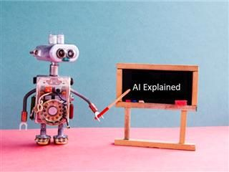

Thank you!
Email: chiragagarwall12@gmail.com
Website: http://chirag126.github.io/
Questions?
@_cagarwal

